Slide 1
OPERATING SYSTEMS Module 3

Slide 2
Deadlocks
In a multiprogramming environment, several processes may compete for a finite number of resources.
A process requests resources; and if the resources are not available at that time, the process enters a waiting state.
Sometimes, a waiting process is never again able to change state, because the resources it has requested are held by other waiting processes.
This situation is called a deadlock.
Dept. of AIML

Slide 3
System Model
A system consists of a finite number of resources to be distributed among a number of competing processes.
The resources are partitioned into several types, each consisting of some number of identical instances.
Example of resource types
Memory space
CPU cycles
Files
I/O devices :- Printers and DVD drives
Dept. of AIML

Slide 4
Under the normal mode of operation, a process may utilize a resource in only the following sequence:
1 Request
If the request cannot be granted immediately (for example, if the resource is being used by another process), then the requesting process must wait until it can acquire the resource.
2. Use
The process can operate on the resource (for example, if the resource is a printer, the process can print on the printer)
3. Release
The process releases the resource.
Dept. of AIML

Slide 5
Deadlock Characterization
In a deadlock, processes never finish executing, and system resources are tied up, preventing other jobs from starting.
Features that characterize deadlocks:- Necessary conditions
A deadlock situation can arise if the following four conditions hold simultaneously in a system:
Mutual exclusion. At least one resource must be held in a non-sharable mode; that is, only one process at a time can use the resource. If another process requests that resource, the requesting process must be delayed until the resource has been released.
Dept. of AIML

Slide 6
Hold and wait. A process must be holding at least one resource and waiting to acquire additional resources that are currently being held by other processes.
No preemption. Resources cannot be preempted; that is, a resource can be released only voluntarily by the process holding it, after that process has completed its task.
Circular wait. A set { P₀, ••• , P_{n}} of waiting processes must exist such that Po is waiting for a resource held by P₁, P₁ is waiting for a resource held by P2 , ... , P_{n-1} is waiting for a resource held by Pn.
Dept. of AIML

Slide 7
We emphasize that all 4 conditions must hold for a deadlock to occur.
Mutual exclusion
Hold and wait
No preemption
Circular wait
Dept. of AIML

Slide 8
Resource Allocation Graph
Deadlocks can be described precisely with a DIRECTED GRAPH called system resource allocation graph.
This graph consists of a set of vertices V and a set of edges E.
The set of vertices V is partitioned into two different types of nodes:
P = {P1, P2, . . . , Pn}, the set consisting of all the active processes in the system, and
R = {R1, R2, . . . , Rm} the set consisting of all resource types in the system.
[Request Edge]
A directed edge from process Pi to resource type R; is denoted by Pi -> R_{j}; it signifies that process Pi has requested an instance of resource type Rj and is currently waiting for that resource.
Dept. of AIML

Slide 9
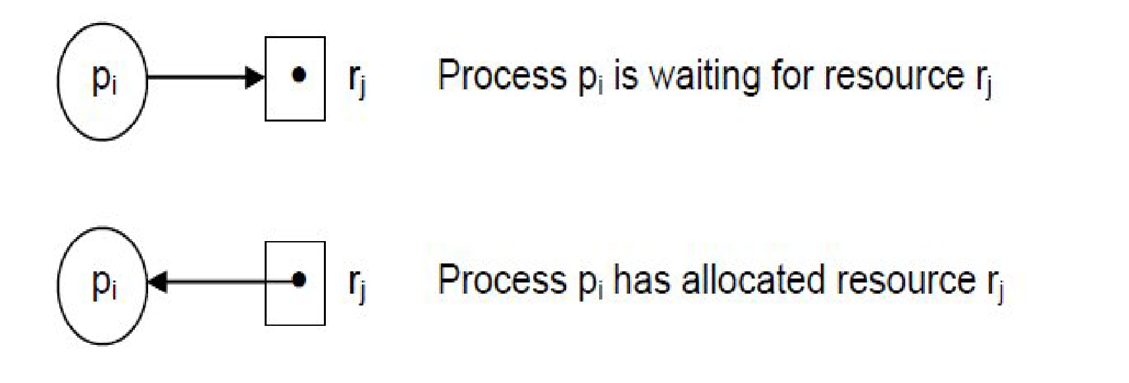
[Assignment Edge]
A directed edge from resource type Rj to process Pi is denoted by R_{j}; 🡪Pi; it signifies that an instance of resource type Rj has been allocated to process Pi.
Processes are represented using circles
Resources are denoted using rectangles.
Since a resource type Rj may have more than one instance, we represent each such instance as a dot within the rectangle.
Dept. of AIML

Slide 10
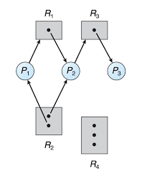
P = {P1, P2, P3}
R = { R1, R2, R3, R4}
£ = { P1 → R1, P2 →R3, R1 →P2, R2 →P2, R2 → P1,
R3→ P3}
Resource instances:
One instance of resource type R1
Two instances of resource type R2
One instance of resource type R3
Three instances of resource type R4
Dept. of AIML
Resource allocation graph.

Slide 11
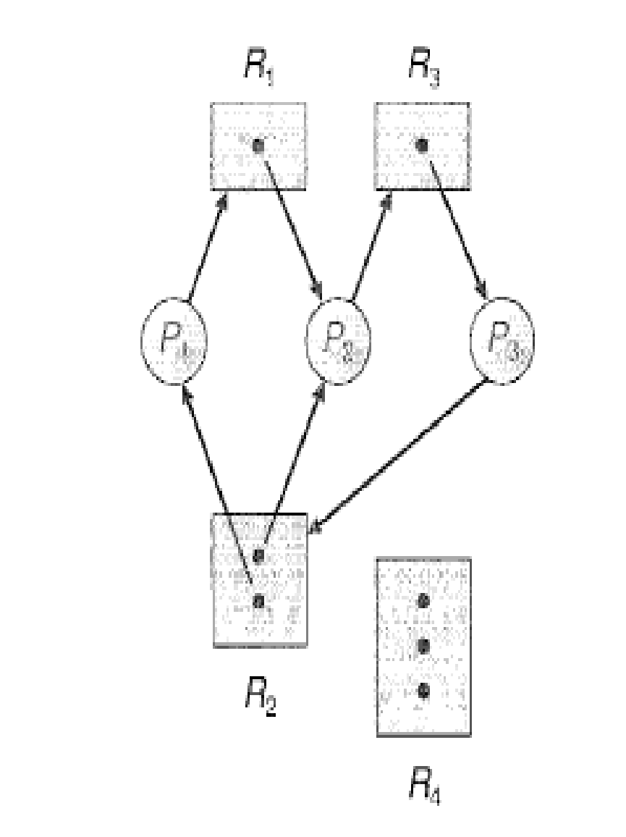
If the graph contains no cycles, then no process in the system is deadlocked.
If the graph does contain a cycle, then a deadlock may exist.
At this point, two minimal cycles exist in the system
P1 → R1 → P2 → R3 → P3 → R2 → P1
P2 → R3 → P3 → R2 → P2
Dept. of AIML
Processes P1, P2 and P3 are deadlocked
Resource allocation graph with a deadlock.

Slide 12
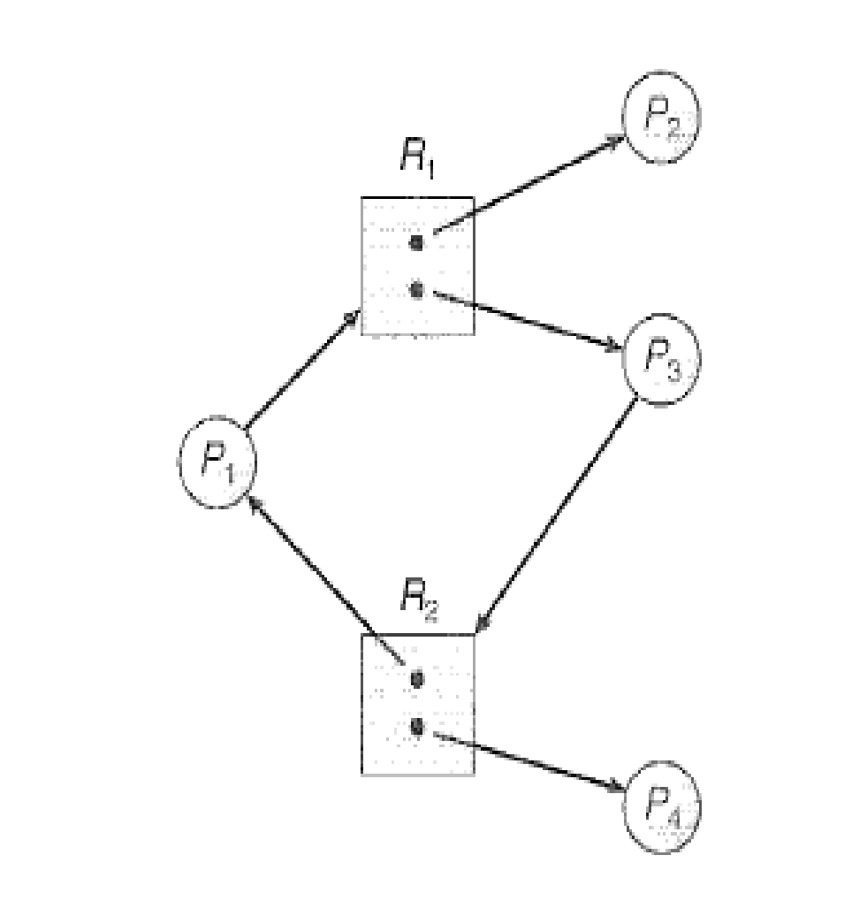
In this example also we have a cycle
P1 → R1 → P3 → R2 → P1
However, there is no deadlock.
Observe that process P4 may release its instance of resource type R2. That resource can then be allocated to P3, breaking the cycle.
Dept. of AIML
Resource allocation graph with a cycle but no deadlock.
If a resource-allocation graph does not have a cycle, then the system is not in a deadlocked state.
If there is a cycle, then the system may or may not be in a deadlocked state.

Slide 13
Methods for Handling Deadlocks
The deadlock problem can be solved in one of three ways:
We can use a protocol to prevent or avoid deadlocks, ensuring that the system will never enter a deadlocked state.
We can allow the system to enter a deadlocked state, detect it, and recover.
We can ignore the problem altogether and pretend that deadlocks never occur in the system.
To ensure that deadlocks never occur, the system can use either a deadlock prevention or a deadlock-avoidance scheme.
Deadlock prevention provides a set of methods for ensuring that at least one of the necessary conditions cannot hold.(i.e., Mutual exclusion, Hold and wait, No preemption, Circular wait)
Dept. of AIML

Slide 14
Deadlock avoidance requires that the operating system be given in advance additional information concerning which resources a process will request and use during its lifetime.
With this additional knowledge, it can decide for each request whether or not the process should wait.
If the system does not employ either a deadlock prevention or a deadlock avoidance algorithm, then a deadlock situation may arise.
In this environment, the system can provide an algorithm that examines the state of the system to determine whether a deadlock has occurred and an algorithm to recover from the deadlock(if a deadlock has indeed occurred)
If a system neither ensures that a deadlock will never occur nor provides mechanism for deadlock detection and recovery, then we may arrive at a situation where the system is in a deadlocked state yet has no way of recognizing what has happened.
Dept. of AIML

Slide 15
In this case, the undetected deadlock will result in deterioration of the system’s performance, because resources are being held by processes that cannot run and because more and more processes, as they make requests for resources, will enter a deadlocked state.
Eventually, the system will stop functioning and will need to be restarted manually.
Dept. of AIML

Slide 16
Deadlock Prevention
For a deadlock to occur, each of the four necessary conditions must hold.
By ensuring that at least one of these (Mutual Exclusion, Hold and Wait, No preemption, Circular Wait) conditions cannot hold, we can prevent the occurrence of a deadlock.
Mutual exclusion
The mutual-exclusion condition must hold for non-sharable resources.
For example, a printer cannot be simultaneously shared by several processes.
Sharable resources, in contrast, do not require mutually exclusive access and thus cannot be involved in a deadlock.
Dept. of AIML

Slide 17
Example: read only files. If several processes attempt to open a red only file at the same time, they can be granted simultaneously access to the file. A process never needs to wait for a sharable resource.
In general, however, we cannot prevent deadlocks by denying the mutual exclusion condition, because some resources are intrinsically non-sharable.
Hold and Wait
To ensure th.at the hold-and-wait condition never occurs in the system, we must guarantee that, whenever a process requests a resource, it does not hold any other resources.
One protocol that can be used requires each process to request and be allocated all its resources before it begins execution.
Dept. of AIML

Slide 18
An alternative protocol allows a process to request resources only when it has none. A process may request some resources and use them. Before it can request any additional resources, however, it must release all the resources that it is currently allocated.
Both of these protocols have two main disadvantages:
Resource utilization may be low
Starvation is possible.
Dept. of AIML

Slide 19
No Preemption
To ensure that this condition does not hold, we can use the following protocol.
If a process is holding some resources and requests another resource that cannot be immediately allocated to it (that is, the process must wait), then all resources currently being held are preempted.
Alternatively, if a process requests some resources, we first check whether they are available. If they are, we allocate them. If they are not, we check whether they are allocated to some other process that is waiting for additional resources. If so, we pre-empt the desired resources from the waiting process and allocate them to the requesting process.
This protocol is often applied to resources whose state can be easily saved and restored later, such as CPU registers and memory space. It cannot be generally be applied to such resources as printers and tape drives.
Dept. of AIML

Slide 20
Circular Wait
A way to ensure that this condition never holds is to impose a total ordering of all resource types and to require that each process requests resources in an increasing order of enumeration.
Example: Suppose Process P1 is allocated resource R5. Now if P1 requests for resources R4 and R3(which are lesser than R5), such requests will not be granted. Only request for resource greater then R5 will be granted.
Developing an ordering, or hierarchy, in itself does not prevent deadlock. It is up to application developers to write programs that follow the ordering.
Dept. of AIML

Slide 21
Deadlock Avoidance
An alternative method for avoiding deadlocks is to require additional information about how resources are to be requested.
Example: In a system with one tape drive and one printer, the system might need to know that process P will request first the tape drive and then the printer before releasing both resources, whereas process Q will request first the printer and then tape drive.
With this knowledge of the complete sequence of requests for each process, the system can decide for each request whether or not the process should wait in order to avoid a possible future deadlock.
Each request requires that in making this decision the system consider the resources currently available, the resources currently allocated to each process, and the future requests and releases of each process.
Dept. of AIML

Slide 22
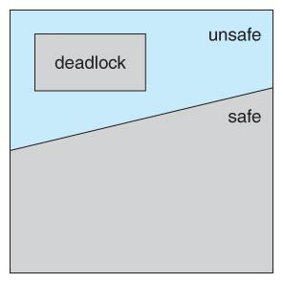
Safe state
A state is safe if the system can allocate resources to each process (up to its maximum) in some order and still avoid a deadlock.
A system is in a safe state only if there exists a safe sequence. A sequence of processes < P₁,P₂, ..., P_{n}> is a safe sequence for the current allocation state it for each Pi, the resource requests that Pi can still make can be satisfied by the currently available resources plus the resources held by all Pi
Dept. of AIML

Slide 23
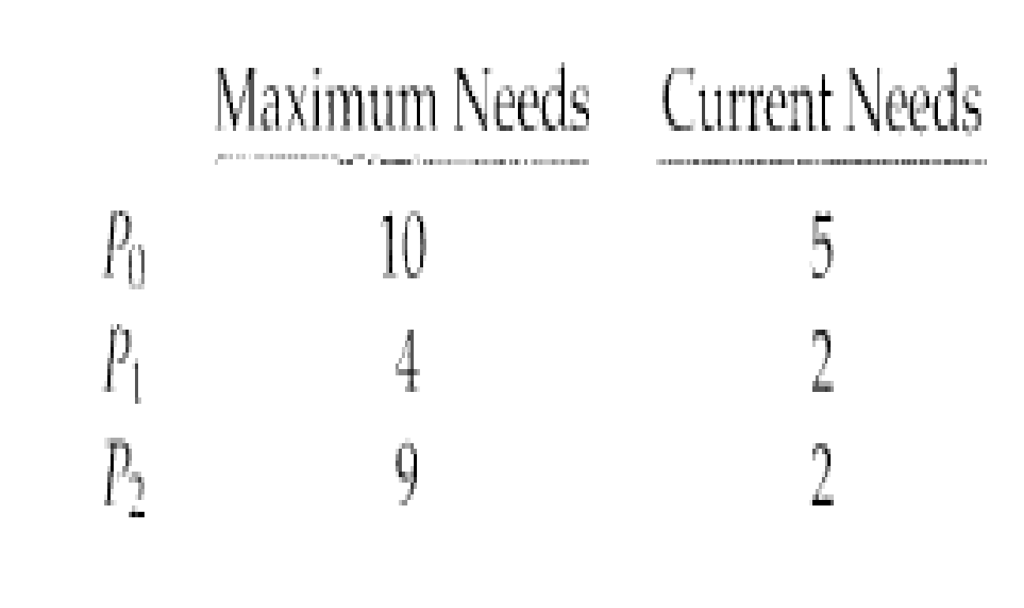
A safe state is not a deadlocked state. Conversely, a deadlocked state is an unsafe state. Not all unsafe states are deadlocks, however.
An unsafe state may lead to a deadlock. As long as the state is safe, the operating system can avoid unsafe (and deadlocked) states. In an unsafe state, the operating system cannot prevent processes from requesting resources such that a deadlock occurs: The behavior of the processes controls unsafe states.
Consider a system with 12 magnetic tape drives and 3 processes:P₀, P₁, and P₂.
Dept. of AIML

Slide 24
At time t₀, the system is in a safe state.
The sequence < P₁, P₀, P₂ > satisfies the safety condition.
A system can go from a safe state to an unsafe state.
Suppose that, at time t₁, process P2 requests and is allocated one more tape drive.
The system is no longer in a safe state.
Dept. of AIML

Slide 25
Resource-Allocation-Graph Algorithm
In addition to the request and assignment edges we introduce a new type of edge, called a claim edge.
A claim edge Pi→Rj indicates that process Pi may request resource Rj at some time in the future.
It resembles a request edge in direction but is represented in the graph by a dashed line.
When process Pi requests resource Rj, the claim edge Pi→Rj is converted to a request edge.
Similarly, when a resource Rj is released by Pi the assignment edge Rj→Pi is reconverted to a claim edge Pi→Rj.
Dept. of AIML

Slide 26
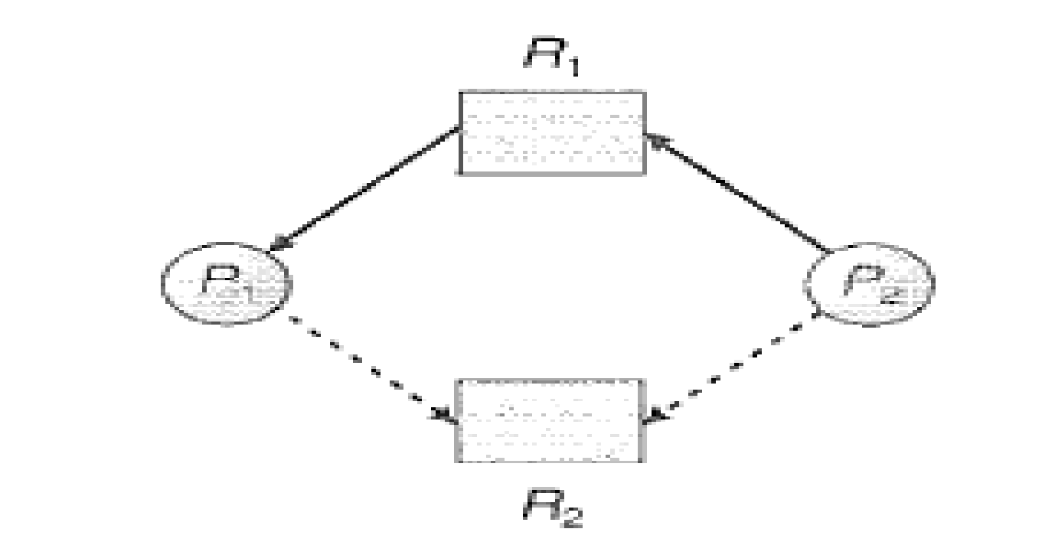
Dept. of AIML
Resource-allocation graph for deadlock avoidance.

Slide 27

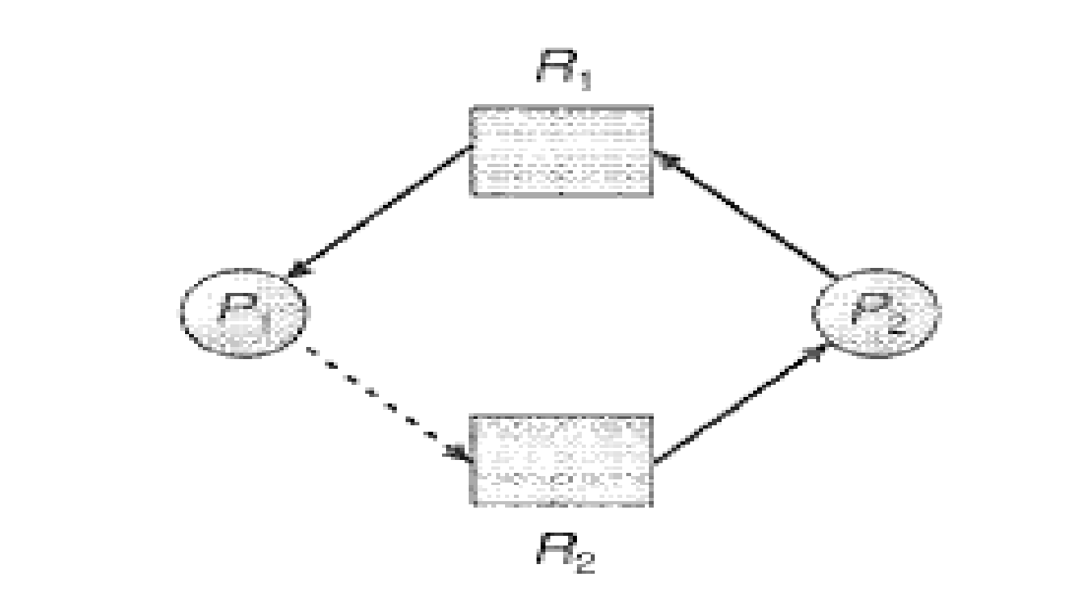
The resource must be claimed prior in the system. That is, before process Pi starts executing, all its claim edges must already appear in the resource allocation graph.
Suppose that process Pi requests resource Rj. The request can be granted only if converting the request edge Pi → Rj to an assignment edge Rj → Pi does not result in the formation of a cycle in the resource allocation graph.
Note that we check for safety by using a cycle detection algorithm.
If no cycle exists, then the allocation of the resource will leave the system in a safe state.
If a cycle is found, then the allocation will put the system in an unsafe state.
Dept. of AIML
Resource-allocation graph for deadlock avoidance.
An unsafe state in a resource-allocation graph.

Slide 28
Deadlock Avoidance
Banker’s algorithm
An algorithm that can be used for deadlock Avoidance in resource allocation systems with multiple instances of each resource type.
It is given the name Banker’s algorithm because the algorithm could be used in a banking system to ensure that the bank never allocated its available cash in such a way that it could no longer satisfy the needs of all its customers.
Let ‘n’ be the number of processes in the system and ‘m’ be the number of resource types.
Several data structures must be maintained to implement the banker's algorithm:
Available. A 1 – D array of size ‘m’ indicating the number of available resources of each type.
If Available[j] = k, there are ‘k’ instances of resource type Rj available.
Dept. of AIML

Slide 29
Max
A 2-D array of size n x m that specifies the maximum demand of each process in a system.
If Max[I,j] = k, then process Pi may request at most ‘k’ instances of resource type Rj.
Allocation
It is a 2-D array of size n x m that specifies the number of resources of each type currently allocated to each process.
If Allocation [I,j] = k, then process Pi is currently allocated ‘k’ instances of resource type Rj
Need
It is a 2-D array of size n x m that indicates the remaining resource needs of each process.
If Need[I,j] = k means process Pi currently need ‘k’ instances of resource type Rj for its execution
Need[I,j] = Max[I,j] - Allocation[I,j].
Dept. of AIML

Slide 30
Safety Algorithm
1. Let Work and Finish be vectors of length ‘m’ and ‘n’ respectively.
Initialize
Work=Available
Finish[i] = false for i=0, 1, 2, ……, n-1.
2. Find an index i such that both
a. Finish[i] == false
b. Need_{i} ≤ Work
if no such i exists, go to step 4
3. Work = Work +Allocation[i]
Finish[i] = true
Go to step 2.
4. If Finish[i] == true for all i,
then the system is in a safe state.
Dept. of AIML

Slide 31
Resource- Request Algorithm
1. If Request_{i} ≤ Need_{i}
go to step 2.
Otherwise, raise an error condition, since the process has exceeded its maximum claim.
2. If Request_{i} ≤ Available,
go to step 3.
Otherwise, Pi must wait, since the resources are not available.
3. Have the system pretend to have allocated the requested resources to process Pi by modifying the state as follows:
Available= Available- Requesti
Allocation(i) =Allocationi + Requesti
Needi = Needi – Requesti
Dept. of AIML

Slide 32
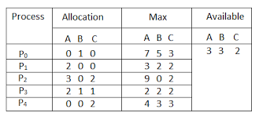
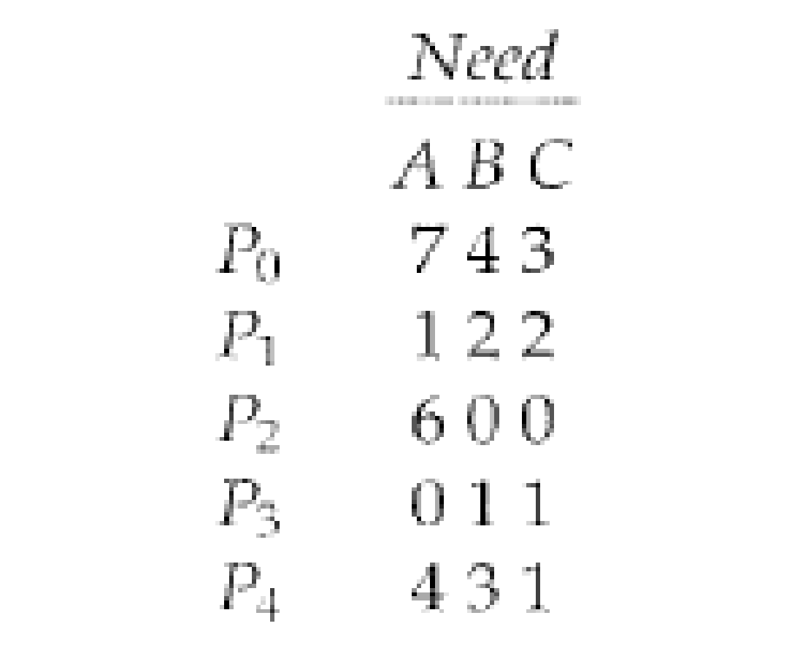
Example of safety Algorithm in Banker’s Algorithm
consider a system with five processes P₀ through P₄ and three resource types A, B, and C. Resource type A has 10 instances (as shown in figure 3.9) , resource type B has 5 instances, and resource type C has 7 instances.
Suppose that, at time T₀, the following snapshot of the system has been taken:
Dept. of AIML
Snapshots of processes at time t₀.
Need matrix of different processes.

Slide 33
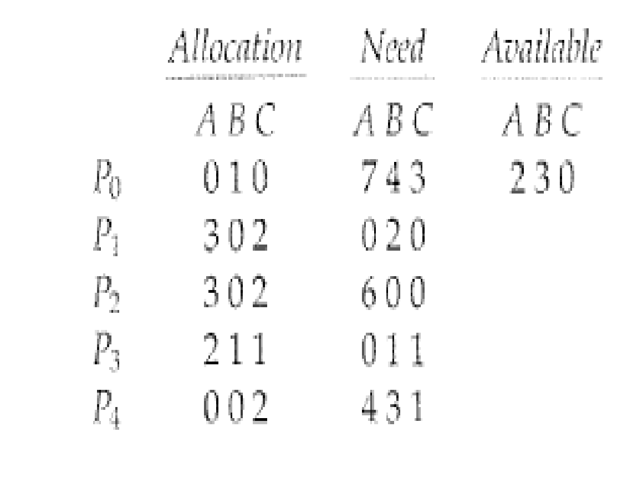
Dept. of AIML
New state after allocation.

Slide 34
Deadlock Detection
Single Instance of Each Resource Type
In systems where each resources have only a single instance. We can use wait for graph which is an algorithm for deadlock detection and is a variant of the resource allocation graph which we have studied earlier.
We obtain this graph from the resource allocation graph by removing the resource nodes and collapsing the appropriate edges.
In a Wait-For-Graph:
An edge from P_{i} and P_{j} indicates that P_{i} is waiting for P_{j} to release a resource that is needed by P_{i}
In a Resource- Allocation Graph, the same would be denoted as P_{i} → R_{k} and R_{k} → P_{j}
Dept. of AIML

Slide 35
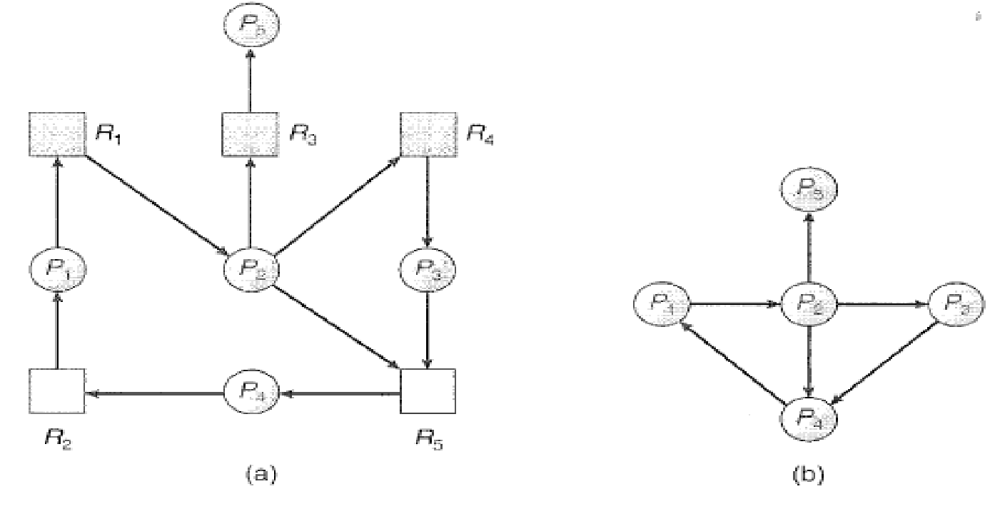
Dept. of AIML
Dept. of AIML
(a) Resource allocation graph (b) Corresponding wait-for graph
As shown in figure 3.12, a deadlock exists in the system if and only if the wait-for graph contains a cycle.

Slide 36
Deadlock Detection
Multiple instances of each Resource Type
This algorithm employs several time-varying data structures that are similar to those used in the Banker’s algorithm.
Available: A vector of length m indicates the number of available resources of each type.
Allocation. An n x m matrix defines the number of resources of each type currently allocated to each process.
Request. An n x m matrix indicates the current request of each process.
If Request[i][j] = k, then process P_{i} is requesting k more instances of resource type R_{j}
Dept. of AIML

Slide 37
The Algorithm:
1. Let Work and Finish be vectors of length ‘m’ and ‘n’ respectively.
Initialize:
Work= Available.
If Allocation ≠ 0, then
Finish[i] = false; else Finish[i] = true, for i = 0,1,. . . ,n-1,
2. Find an i such that both
a. Finish[i] = false
b. Request_{i} ≤ Work
if no such i exists, go to step 4
Dept. of AIML

Slide 38
3. Work = Work + Allocation[i]
Finish[i] = true
Go to step 2
4. If Finish[i] = false for some i, 0≤i≤n, then the system is in the deadlocked state. P_{i} is deadlocked.
Dept. of AIML

Slide 39
Consider a system with five processes P₀ through P₄ and three resource types A, B, and C. Resource type A has 7 instances (as shown in figure 3.9) , resource type B has 2 instances, and resource type C has 6 instances.
Suppose that, at time T₀, the following snapshot of the system has been taken:
Safe sequence we find if we execute algorithm < P0, P2, P3, P1, P4>
Process | Allocation |  |  | Request |  |  | Available
 | A | B | C | A | B | C | A | B | C
P0 | 0 | 1 | 0 | 0 | 0 | 0 | 0 | 0 | 0
P1 | 2 | 0 | 0 | 2 | 0 | 2
P2 | 3 | 0 | 3 | 0 | 0 | 0
P3 | 2 | 1 | 1 | 1 | 0 | 0
P4 | 0 | 0 | 2 | 0 | 0 | 2
Dept. of AIML

Slide 40
Recovery from Deadlock
Process Termination
What to do when a deadlock detection algorithm determines that a deadlock exists?
Possibility 1: Inform the operator that a deadlock has occurred and let the operator deal with the deadlock manually.
Possibility 2: Let the system recover from the deadlock automatically.
How to break from the deadlock?
Option 1: Abort one or more processes to break the circular wait.
Option 2: Preempt some resources from one or more of the deadlocked processes.
Dept. of AIML
Dept. of AIML

Slide 41
Process Termination
To eliminate deadlocks by aborting a process, we use one of two methods:
Abort all deadlocked processes:
Will break the deadlock cycle, but at great expense; the deadlocked processes may have computed for a long time, and the results of these partial computations must be discarded and probably will have to be recomputed later.
Abort one process at a time until the deadlock cycle is eliminated.
Incurs considerable overhead, since, after each process is aborted, a deadlock-detection algorithm must be invoked to determine whether any processes are still deadlocked.
Dept. of AIML

Slide 42
Aborting a process may not be easy
Some examples:
If the process was in the midst of updating a file, terminating it will leave that file in an incorrect state.
If the process was in the midst of printing data on a printer, the system must reset the printer to a correct state before printing the next job.
If the partial termination method is used:
We must determine which deadlocked process should be terminated.
This determination is a policy decision, similar to CPU – Scheduling decisions.
We should abort those processes whose termination will incur the minimum cost.
Dept. of AIML

Slide 43
Some factors that affect which process are chosen to be aborted:
1. What the priority of the process is?
2. How long the process has computed and how much longer the process will compute before completing its designated task?
3. How many and what type of resources the process has used (for example, whether the resources are simple to preempt)?
4. How many more resources the process needs in order to complete?
5. How many processes will need to be terminated?
6. Whether the process is interactive or batch?
Dept. of AIML

Slide 44
Recovery From Deadlock
Resource Preemption
Here we successively preempt some resources from the system and give these resources to other processes until the deadlock cycle is broken.
If preemption is required, then the following three factors to be considered.
Selecting a victim
Rollback
Starvation
Selecting a victim:
Which resources and which processes are to be preempted?
Determine the order of preemption to minimize cost.
Cost: Parameters such as number of resources a deadlocked process is holding and the amount of time the process has thus for consumed during its execution
Dept. of AIML

Slide 45
2. Rollback:
What should be done with a process if we preempt its resources?
It cannot continue it normal execution as its missing some or all of its needed resources.
We must roll back the process to some safe state and restart it from the state.
But what is its safe state?
As it is difficult to determine what a safe state is, the simplest solution is a total rollback.
Abort the process and then restart it.
Dept. of AIML
Dept. of AIML

Slide 46
3. Starvation:
How do we ensure that starvation will not occur?
How can we guarantee that resources will not always be pre-empted from the same process?
If victim selection is based primarily on cost factors, it may happen that the same process is always picked as a victim. As a result, this process never completes its designated task.
We must ensure that a process can be picked as a victim only a (small) finite number of times.
Solution: Include the number of rollbacks in the cost factor.
Dept. of AIML

Slide 47
THANK YOU
Dept. of AIML

Slide 48
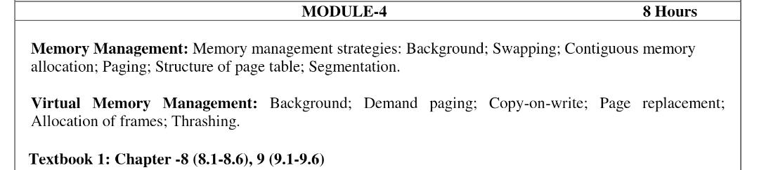
Module 4
Dept. of AIML

Slide 49
Memory management
The main purpose of a computer system is to execute programs.
During execution, these programs, together with the data they access, must be in main memory (at least partially)
In CPU scheduling we showed how the CPU can be shared by a set of processes.
As a result of CPU scheduling CPU utilization, as well as speed of the computer’s response to its users could be improved.
To realize this increase in performance, however, we must keep several processes in memory that is, we must have shared memory.
Dept. of AIML

Slide 50
Main Memory
Basic Hardware
Memory consists of a large array of words or bytes, each with its own address.
The CPU fetches instructions from memory according to the value of the program counter.
These instructions may cause additional loading from and storing to specific memory addresses.
A typical instruction-execution cycle first fetches an instruction from memory.
The instruction is then decoded and may cause operands to be fetched from memory. After the instruction has been executed on the operands, results may be stored back in memory.
Dept. of AIML

Slide 51
CPU can directly access only Main memory and the registers built into the processor.
There are machine instructions that take memory addresses as arguments, but none that take disk addresses.
So, any instructions in execution, and any data being used by the instructions, must be in one of these direct access storage devices.
If the data are not in memory, they must be moved there before the CPU can operate on them.
CPU Cycle Time for accessing memories
Registers :- Accessible within one cycle of the CPU clock.
Most CPUs can decode instructions and perform simple operations on register contents at the rate of one or more operations per clock tick.
Dept. of AIML

Slide 52
Main Memory:- Access may take many cycles of the CPU clock to complete
In this case, the processor normally needs to stall, since it does not have the data required to complete the instruction that it is executing.
This situation is intolerable because of the frequency of memory accesses.
Remedy:- Add fast memory between the CPU and main memory.
A memory buffer used to accommodate a speed differential, called a cache.
Dept. of AIML

Slide 53
Protection of OS from unauthorized access
The OS has to be protected from access by user processes.
In addition, user processes must be protected from one another.
This protection must be provided by the hardware.
This is done by ensuring that each process has a separate memory space.
To do this, we need the ability to determine the range of legal addresses that the process may access and to ensure that the process can access only these legal addresses.
This protection is provided by using two registers, usually a base and a limit
Dept. of AIML

Slide 54
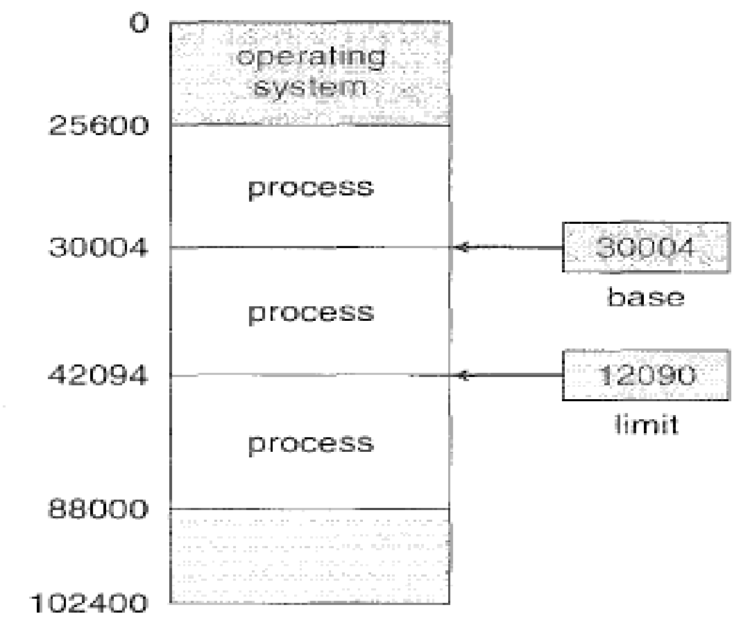
Dept. of AIML
A base and a limit register define a logical address space.

Slide 55
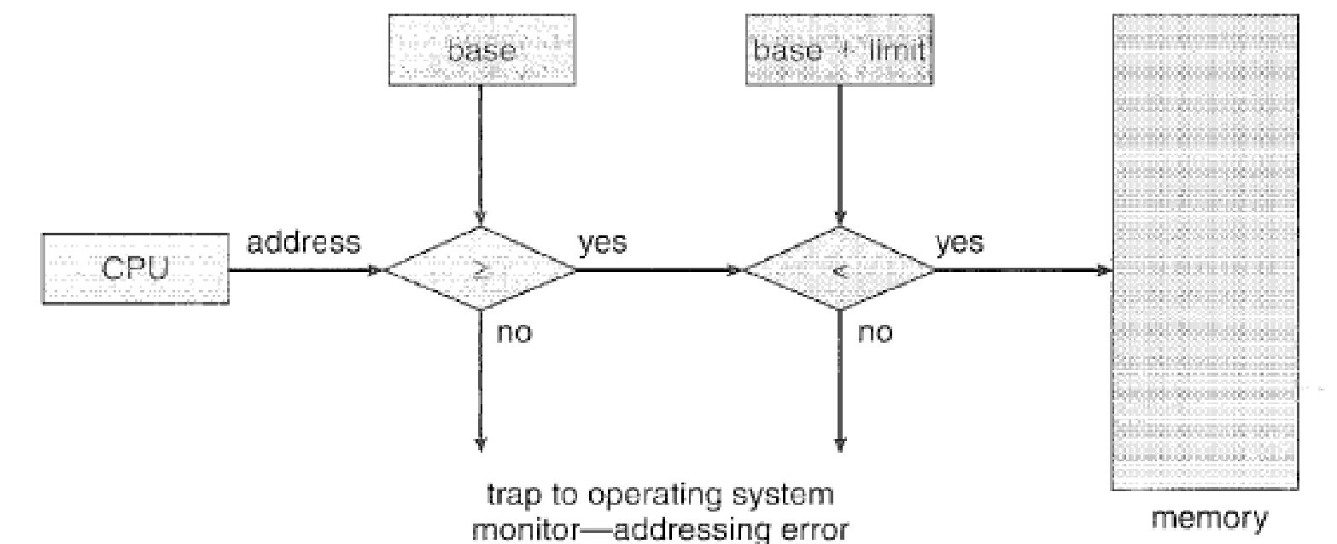
A base and a limit register define a logical address space.
The base register holds the smallest legal physical memory address.
The limit register specifies the size of the range.
For example, if the base register holds 300040 and the limit register is 120900, then the program can legally access all addresses from 300040 through 420939 (inclusive).
Dept. of AIML
Hardware address protection with base and limit registers

Slide 56
The base and limit registers can be loaded only by the operating system, which uses a special privileged instruction.
Since privileged instructions can be executed only in kernel mode, and since only the operating system executes in kernel mode, only the operating system can load the base and limit registers.
This scheme allows the OS to change the value of the registers but prevents user programs from changing the registers contents.
Dept. of AIML

Slide 57
Address binding
Usually, a program resides on a disk as a binary executable file.
To be executed, the program must be brought into memory and placed within a process. Depending on the memory management in use, the process may be moved between disk and memory during its execution.
The processes on the disk that are waiting to be brought into memory for execution form the input queue.
Input queue → Select a process → Loads it into memory → Executes and accesses instructions and data from memory → Process terminates → Memory space is declared available
Dept. of AIML

Slide 58
Most systems allow a user process to reside in any part of the physical memory.
Though address space of the computer starts at 00000, the first address of the user process need not be 00000.
In most cases, a user program will go through several steps during COMPILE TIME, LOAD TIME, EXECUTION TIME before being executed.
Addresses may be represented in different ways during these steps.
Source program:- Addresses are generally symbolic (such as count)
Compiler:- Typically binds these symbolic addresses to relocatable addresses (such as “14 bytes from the belonging of this module”)
Linkage editor or Loader:- Binds the relocatable addresses to absolute addresses (such as 74014)
Each binding is a mapping from one address space to another.
Dept. of AIML

Slide 59
Binding of instructions and data to memory addresses during
Compile time. If you know at compile time where the process will reside in memory, then absolute code can be generated.
For example, if you know that a user process will reside starting at location R, then the generated compiler code will start at that location and extend up from there.
If, at some later time, the starting location changes, then it will be necessary to recompile this code.
Load time. If it is not known at compile time where the process will reside in memory, then the compiler must generate relocatable code.
In this case, final binding is delayed until load time. If the starting address changes, we need only reload the user code to incorporate this changed value.
Dept. of AIML

Slide 60
Execution time. If the process can be moved during its execution from one memory segment to another, then binding must be delayed until run time.
Special hardware must be available for this scheme to work. Most general-purpose operating systems use this method.
Dept. of AIML

Slide 61
Logical versus Physical Address Space
Logical Address:- An address generated by the CPU
Physical Address:- An address seen by the memory unit-that is, the one loaded into memory address register of the memory.
The compile-time and load-time address-binding methods generate identical logical and physical addresses.
Execution-time address binding scheme results in differing logical and physical address.
In this case, we usually refer to the logical address as virtual address.
Dept. of AIML
Dept. of AIML

Slide 62
Logical Address Space:- The set of all logical addresses generated by a program.
Physical Address Space:- The set of all physical addresses corresponding to these logical addresses.
In the execution time address binding scheme, the logical and physical address spaces differ.
The run time mapping from virtual to physical addresses is done by a hardware device called the Memory Management Unit (MMU)
Dept. of AIML

Slide 63
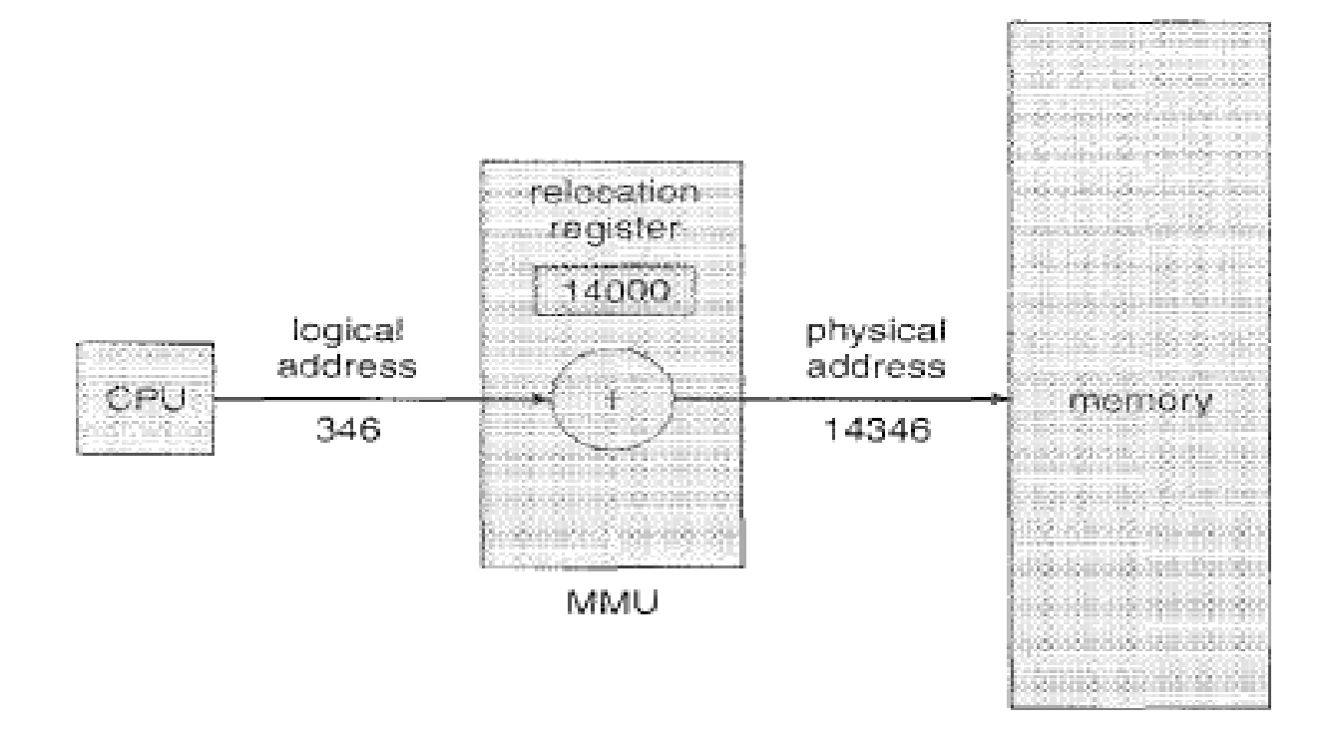
Dept. of AIML
Dynamic relocation using a relocation register.

Slide 64
We now have two different types of addresses:
Logical addresses (in the range 0 to max) and
Physical addresses (in the range R + 0 to R + max for a base value R)
The user generates only logical addresses and thinks that the process runs in locations 0 to max.
The user program supplies logical addresses, these logical addresses must be mapped to physical addresses before they are used.
Dept. of AIML

Slide 65
Dynamic Loading
As we have discussed so for, the entire program and all data of a process must in physical memory for the process to execute.
The size of a process is thus limited to the size of physical memory.
To obtain better memory-space utilization, we can use dynamic loading.
With dynamic loading, a routine is not loaded until it is called.
All routines are kept on disk in a relocatable load format.
The main program is loaded into memory and is executed.
Dept. of AIML

Slide 66
When a routine needs to call another routine, the calling routine first checks to see whether the other routine has been loaded.
If not, the relocatable linking loader is called to load the desired routine into memory and to update the program’s address tables to reflect the change.
Then control is passed to the newly loaded routine.
Advantages
An unused routine is never loaded.
This method is particularly useful when large amounts of code are needed to handle infrequently occurring cases.
Although the total program size may be large, the portion that is used( and hence loaded) may be much smaller.
Dept. of AIML

Slide 67
Dynamic loading does not require special support from the operating system.
It is the responsibility of the users to design their programs to take advantage of such a method.
Dept. of AIML

Slide 68
Dynamic Linking and Shared Libraries
When a program runs, apart from its own modules, it also needs to use certain system libraries as well.
Static Linking:- System language libraries are treated like any other object module and are combined by the loader into the binary program image.
Disadvantage:- Each program on a system must include a copy of its language library (or at least the routines referenced by the program) in the executable image. This requirement both disk and main memory space.
Dynamic loading :- Checks to see whether the needed routine is already in memory.
If not, the routine is loaded into memory.
Dept. of AIML

Slide 69
The concept of dynamic linking is similar to that of dynamic loading. But here, linking rather than loading, is postponed until execution time.
Dynamically Linked Libraries
With dynamic linking, a stub is included in the image for each library routine reference.
Stub :- A small piece of code that indicates how to locate the appropriate memory resident library routine or how to load the library if the routine is not already present.
When the stub is executed, it checks to see whether the neede routine is already in memory.
Dept. of AIML

Slide 70
If not, the program loads the routine into memory.
Either way, the stub replaces itself with the address of the routine and execute the routine.
Thus, the next time that particular code segment is reached, the library routine is executed directly, incurring no cost for dynamic linking.
Dept. of AIML

Slide 71
Swapping
A process must be in memory to be executed.
A process, however, can be swapped temporarily out of memory to a backing store and then brought back into memory for continued execution.
Example
In a multiprogramming environment with a round-robin CPU-scheduling algorithm.
When a quantum expires, the memory manager will start to swap out the process that just finished and to swap another process into the memory space that has been freed.
Dept. of AIML

Slide 72
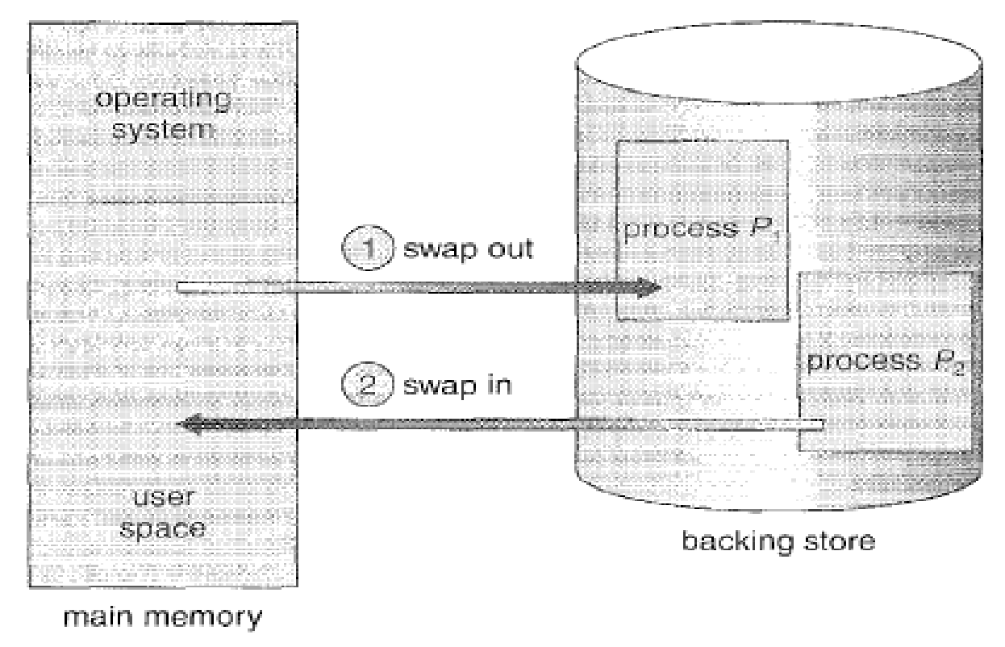
Dept. of AIML
Swapping of two processes using a disk as a backing store.

Slide 73
Memory space where Swapping happens
Normally
A process that is swapped out will be swapped back into the same memory space it occupied previously.
But it depends on the address binding method.
If binding is done at assembly or load time : The process cannot be easily moved to a different location.
If the binding is done at execution time:- The process can be swapped into a different memory space, because the physical addresses are computed during execution time.
Dept. of AIML

Slide 74
Backing store
Swapping requires a backing store.
The backing store is commonly a fast disk.
It must be large enough to accommodate copies of all memory images for all users.
It must provide direct access to these memory images.
The system maintains a ready queue consisting of all processes whose memory images are on the backing store or in memory and are ready to run.
Whenever the CPU scheduler decides to execute a process, it calls the dispatcher.
Dept. of AIML

Slide 75
The dispatcher checks to see whether the next process in the queue is in memory.
If it is not, and if there is no free memory region, the dispatcher swaps out a process currently in memory and swaps in the desired process.
It then reloads registers and transfers control to the selected process.
Dept. of AIML

Slide 76
Swap Time
The context switch time in a swapping system is fairly high.
Example
Let user process Size = 10MB
Transfer Rate of Backing Store = 40MB per second.
Actual transfer of the 10MB process to or from main memory takes- 10000KB/40000KB per second = ¼ second = 250milliseconds.
Assuming that no head seeks are necessary, and assuming an average latency of 8 milliseconds, the swap time = 258 milliseconds.
Since we must both swap out and swap in, the total swap time is = 258 x 2 = 516milliseconds.
Dept. of AIML

Slide 77
For efficient CPU utilization, we want the execution time for each process to be long relative to the swap time.
Thus, in a round robin CPU scheduling algorithm, for example, the time quantum should be substantially larger than 0.516seconds.
The major part of the swap time is transfer time.
The total transfer time is directly proportional to the amount of memory swapped.
Other factors that affect swapping
Dept. of AIML

Slide 78
A process must be completely idle in order to be swapped.
A process may be waiting for an I/O operation when we want to swap that process to free up memory.
If the I/O is asynchronously accessing the user memory for I/O buffers, then the process cannot be swapped.
Dept. of AIML

Slide 79
Memory Allocation
How to allocate memory?
Divide memory into several fixed sized partitions.
Each partition may contain exactly one process.
When a partition is free, a process is selected form the input queue and is loaded into the free partition.
When the process terminates, the partition become available for another process.
This is one of the simplest methods for allocating memory.
Dept. of AIML

Slide 80
Dynamic Storage Allocation Problem
How to satisfy a request of size n from a list of free partitions/holes in main memory?
Solutions:
First fit
Best fit
Worst fit
First fit
Allocate the first hole that is big enough.
Searching can start either at the beginning of the set of holes or where the previous first-fit search ended.
We can stop searching as soon as we find a free hole that is large enough.
Dept. of AIML

Slide 81
Best fit
Allocate the smallest hole that is big enough.
We must search the entire list, unless the list is ordered by size.
This strategy produces the smallest leftover hole.
Worst fit
Allocate the largest hole.
Again, we must search the entire list, unless it is sorted by size.
This strategy produces the largest leftover hole, which may be more useful than the smaller leftover hole from a best-fit approach.
Dept. of AIML

Slide 82
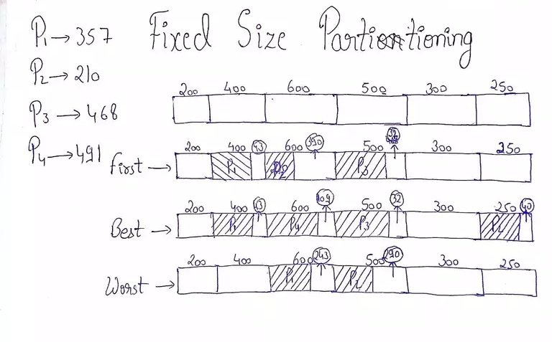
Dept. of AIML

Slide 83
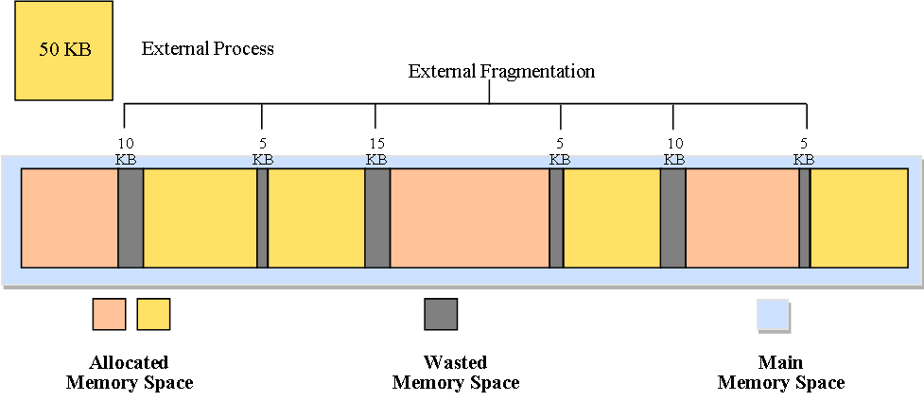
Fragmentation
As processes are loaded and removed from memory, the free memory space is broken into little pieces which results in fragmentation.
Types of fragmentation:
External fragmentation
Internal fragmentation
External fragmentation exists when there is enough total memory space to satisfy a request, but the available spaces are not contiguous.
Storage is fragmented into a large number of small holes.
This fragmentation problem can be severe. In the worst case, we could have a block of free (or wasted) memory between every two processes.
Dept. of AIML

Slide 84
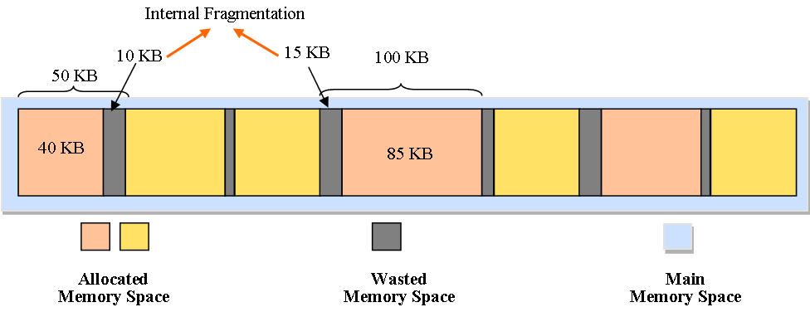
If all these small pieces of memory were in one big free block instead. We might be able to run several more processes.
Internal fragmentation
It occurs when memory blocks assigned to processes are bigger than what the process actually needs.
Some portion of memory is left unused, as it cannot be used by another process.
Solution: Make use of Best Fit approach for allocating memory segments to processes.

Slide 85
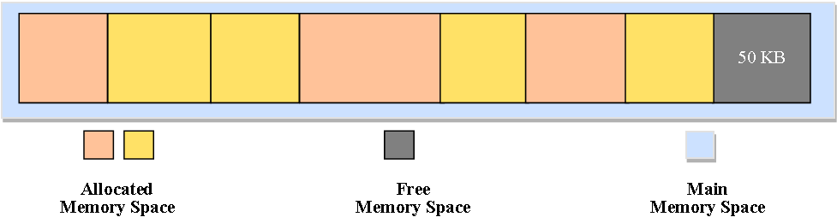
Solution to external fragmentation
Compaction
Shuffle the memory contents so as to place all free memory together in one large block.
Cons:
Compaction is not always possible.
If relocation is static and is done at assembly or load time, compaction cannot be done.
It is possible only if relocation is dynamic and is done at execution time.
Dept. of AIML

Slide 86
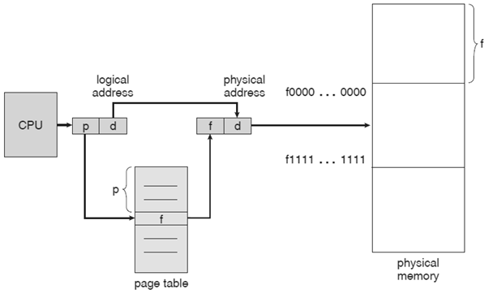
Paging
Paging is a memory-management scheme that permits the physical address space of a process to be noncontiguous.
Paging avoids the considerable problem of fitting memory chunks of varying sizes onto the backing store.
Most memory-management schemes used before the introduction of paging suffered from this problem.
Dept. of AIML

Slide 87
Page Table
Every address generated by the CPU is divided into two parts: a page number (p) and a page offset (d).
Address of the each of data that is present inside the pages of the particular process consists of Page number(p) :- Used as an index into a page table.
Page offset(d) : - The displacement within the page.
The page table contains the base address of each page in physical memory. This base address is combined with the page offset to define the physical memory address that is sent to the memory unit.
Dept. of AIML

Slide 88
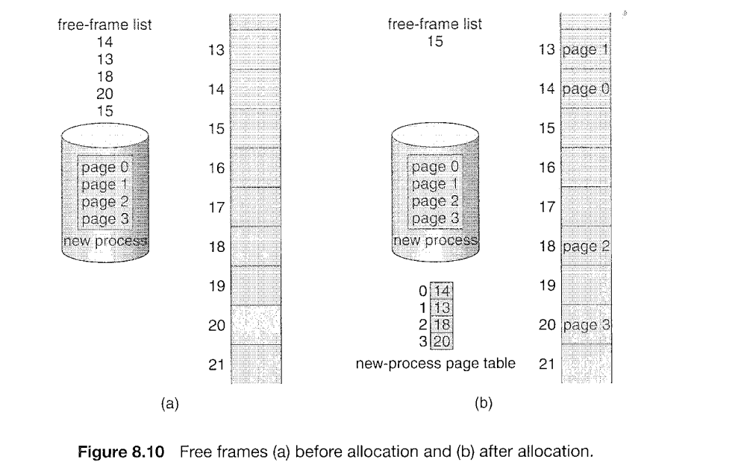
Dept. of AIML
Paging model of logical and physical memory

Slide 89
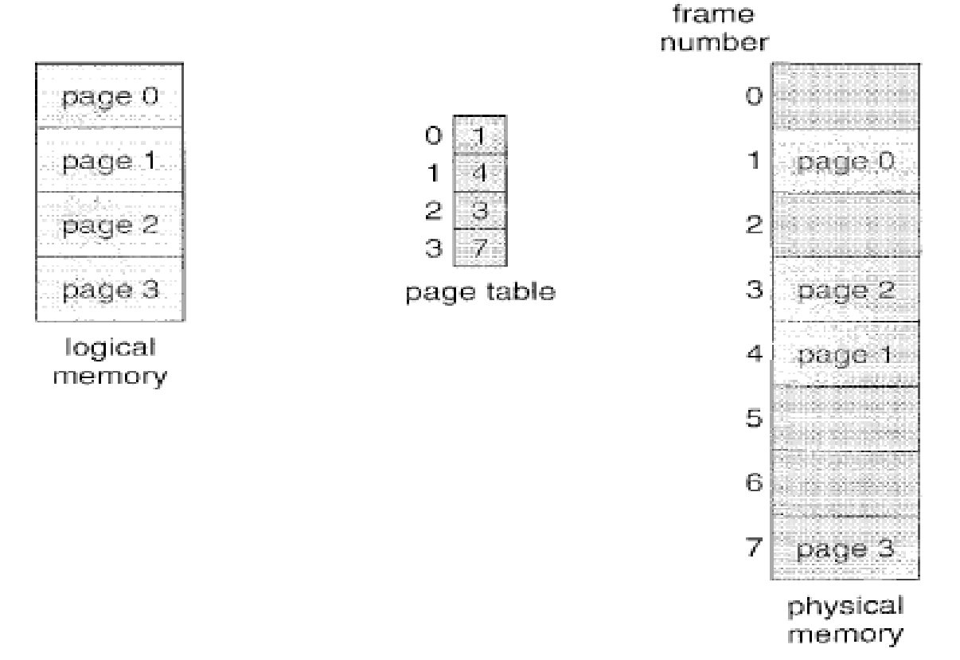
Dept. of AIML
Paging model of logical and physical memory

Slide 90
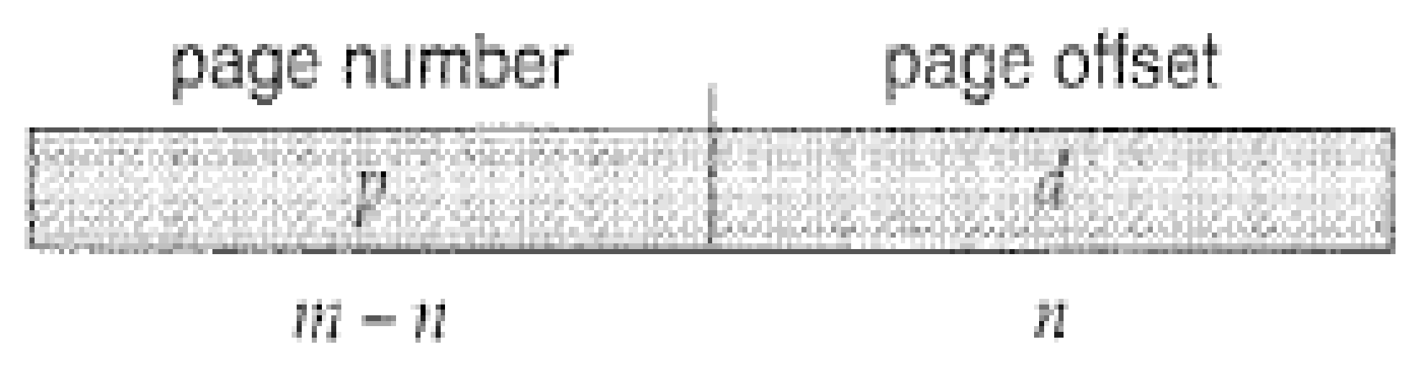
Translation of Logical Address to Physical Address using Page Table
Every address generated by the CPU is divided into two parts:
A page number (p) and A page offset (d)
page number and page offset
Dept. of AIML
Page number(p) :- Used as an index into the page table
Page Offset(d) :- The displacement within the page.

Slide 91
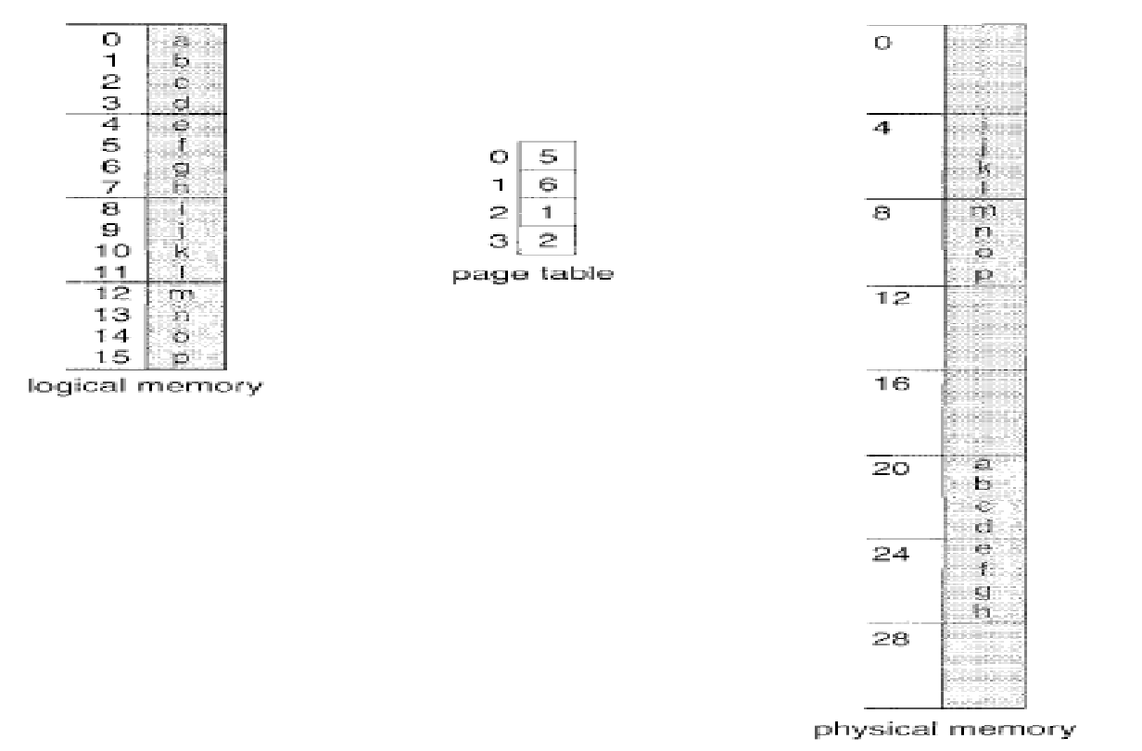
Dept. of AIML
Translation of Logical Address to Physical Address using Page Table

Slide 92
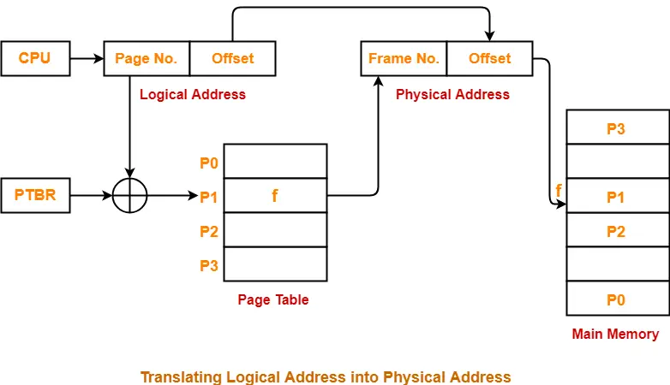
Hardware implementation of Page Table
Case 1: Implement the page table as a set of dedicated registers.
Problem: This can be used only when page table is reasonably small.
Case 2: Keep the page table in main memory and a page table base register (PTBR) points to the page table.
Problem: The time required to access a user memory location is increased as there are two memory accesses needed to access a byte (one for the page table entry, one for the byte)
Dept. of AIML

Slide 93
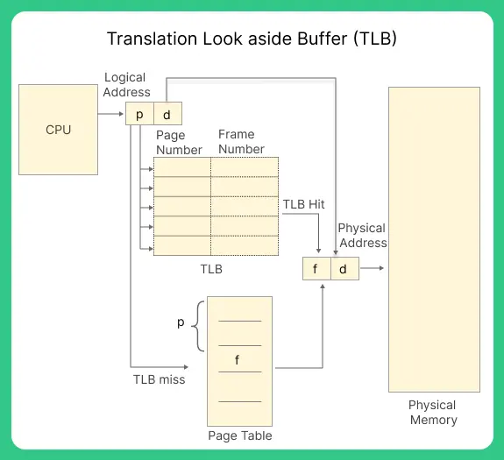
Translation Lookaside Buffer(TLB)
The TLB is associative, high speed memory.
It consists of two parts
A key
A value
When the associative memory is presented with an item, the item is compared with all keys simultaneously.
If the item is found, the corresponding value field is returned.
The search is fast.
Dept. of AIML

Slide 94
Usage of TLB with Page Table
The TLB contains only a few of the page table entries
When a logical address is generated by the CPU, its page number is presented to the TLB.
If the page number is found, its frame number is immediately available and is used to access memory → TLB Hit
If the page number is not in the TLB, a memory reference to the page table must be made. → TBL Miss
When the frame number is obtained, we can use it to access memory.
Also we add the page number and frame number to the TLB, so that they will be found quickly on the next reference.
Dept. of AIML

Slide 95
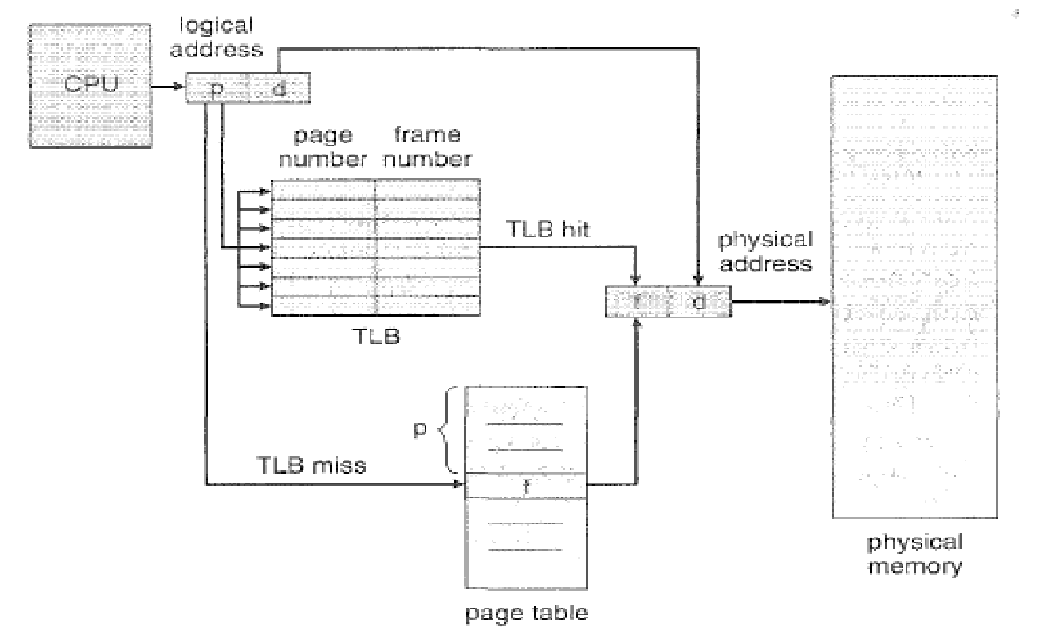
Dept. of AIML
Paging hardware with TLB.

Slide 96
Protection - Page Table Entries
Page table entries contains several information about pages which vary from OS to OS.
The most important information in a page table entry is the frame number.
The remaining information are optional.
Frame number denotes the frame where the page is present in the main memory.
The number of bits required for this depends on the number of frames in the main memory.
The Present /Absent bit specifies whether the page is present in the main memory or not.
It is also called Valid/Invalid bit.
If the page we are looking for it not present in main memory, it is called PAGE FAULT.
If the page we are looking for it is not present in main memory, the Present/Absent bit is set to 0.
Dept. of AIML

Slide 97
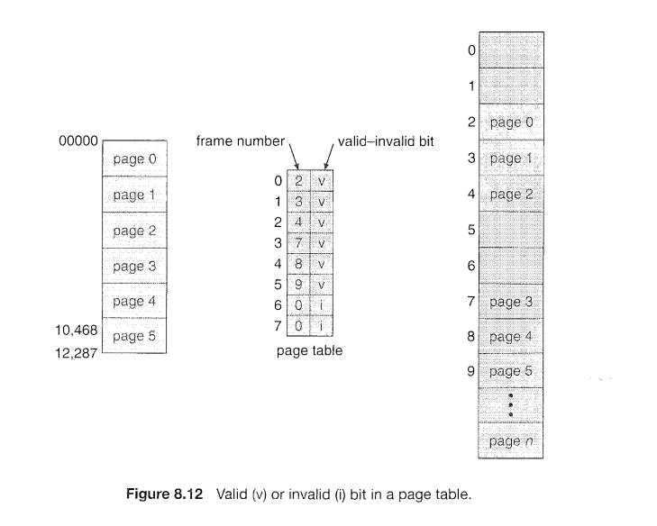
Dept. of AIML

Slide 98
The protection bit also known as Read/Write bit is used for page protection.
It specifies the permissions for read or write operations on the page.
The bit is set to 0 if only read operation is allowed.
The bit is set to 1 if both read and write operations are allowed.
The reference bit specifies whether the page has been referenced in the last clock cycle or not.
It is set to 1 when page is accessed.
The caching bit is used for enabling or disabling caching of the page.
When we need fresh data we have to disable caching so as to avoid fetching of old data from the cache.
When caching has to be disabled, this bit is set to 1. Otherwise it is set 0.
Dept. of AIML

Slide 99
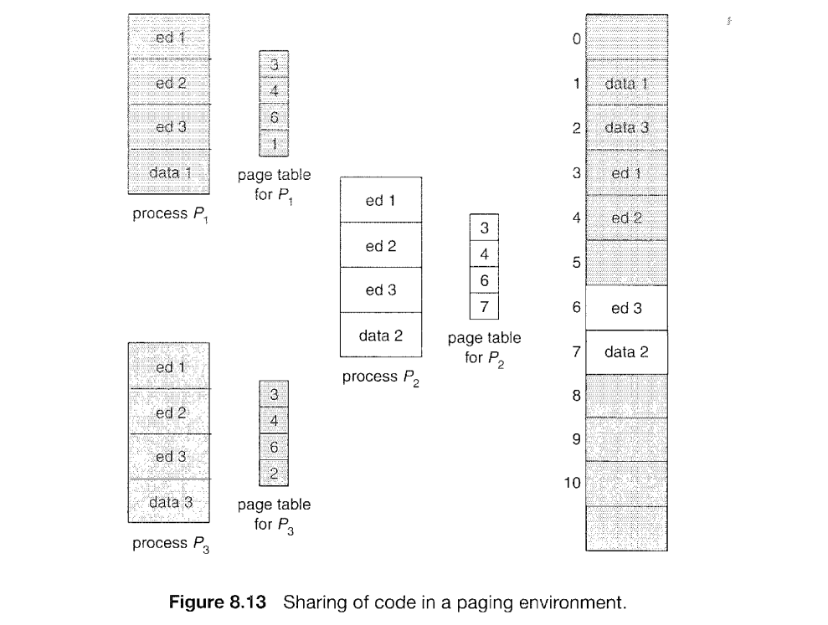
SHARED DATA
Dept. of AIML

Slide 100
The Dirty bit is also known as the Modified bit.
It Specifies whether the page has been modified or not.
If the page has been modified, then this bit is set to 1otherwise set to 0.
This bit helps in avoiding unnecessary writes to the secondary memory when a page is being replaced by another page.
Dept. of AIML

Slide 101
Shared Pages
An advantage of paging is the possibility of sharing common code.
This is particularly important in a time-sharing environment.
Consider a system that supports 40 users, each of whom executes a text editor.
If the text editor consists of 150 KB of code and 50 KB of data space,
we need, (150 x 40) + (50 x 40) = 6000 + 2000 = 8,000 KB to support the 40 users.
However, If the code is reentrant code (or pure code), it can be shared among different processes.
Code that is non self modifying code. It never changes during execution.
Thus, 2 or more processes can execute the same code at the same time.
Dept. of AIML

Slide 102
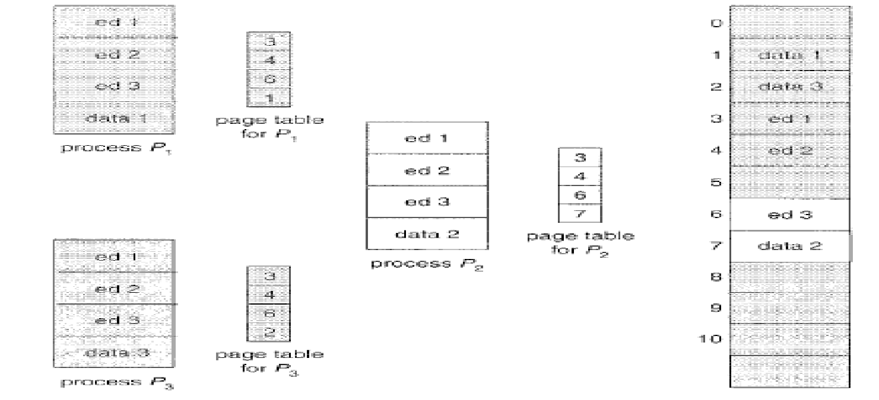
Each process has its own copy of registers and data storage to hold the data for the process’s execution. The data for two different processes will, of course, be different.
Sharing of code in a paging environment.

Slide 103
An advantage of paging is the possibility of sharing common code.
This is particularly important in a time-sharing environment.
Consider a system that supports 40 users, each of whom executes a text editor. If the text editor consists of 150 KB of code and 50 KB of data space,
we need, (150 x 40) + (50 x 40) = 6000 + 2000 = 8,000 KB to support the 40 users.
Now, if the code is shared, we need:
150 + (50 x 40) = 150 + 2000 = 2150 KB to support 40 users.
Dept. of AIML

Slide 104
Hierarchical paging
Most modern computer systems support a large logical address space (2³² to 2⁶⁴).
In such an environment, the page table itself becomes excessively large.
For example, consider a system with:
32-bit logical address space.
If the page size in such a system is 4 KB (2¹²)
Dept. of AIML

Slide 105
Then a page table may consist of up to (2³² /2¹²) = 1 million entries(approx.)
Consider each entry consists of 4 bytes
So, each process may need up to ( 4 x 1 million) bytes = 4MB of physical address space
Trying to collect a page table of this size contiguously in main memory is clearly not a good idea.
Dept. of AIML

Slide 106
Solution: Divide the page table into smaller sizes.
Multilevel Paging
Use a two level paging algorithm, in which the page table itself is also paged.
Page number Page offset
20 12 = 32 bits
Page number(p): - Used as an index into a page table
Page offset (d) :- The displacement within the page
p | d
Dept. of AIML

Slide 107
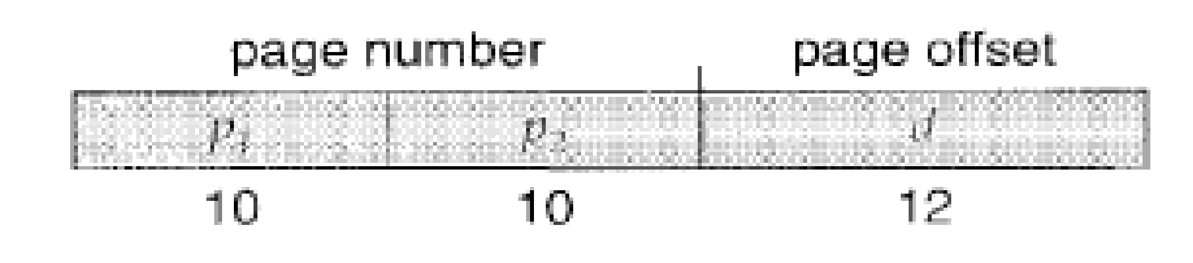
An example of logical address space division
P1 is an index into the outer page table
P2 is the displacement within the page of the outer page table.
Page offset(d) – The displacement within the page.
Dept. of AIML

Slide 108
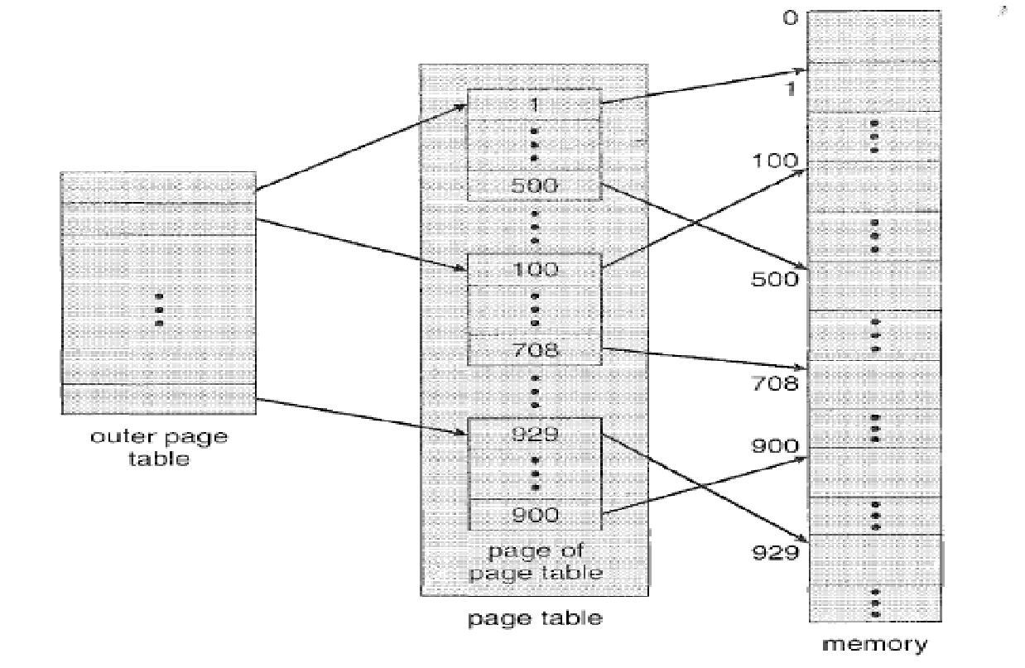
Dept. of AIML
A two-level page-table scheme

Slide 109
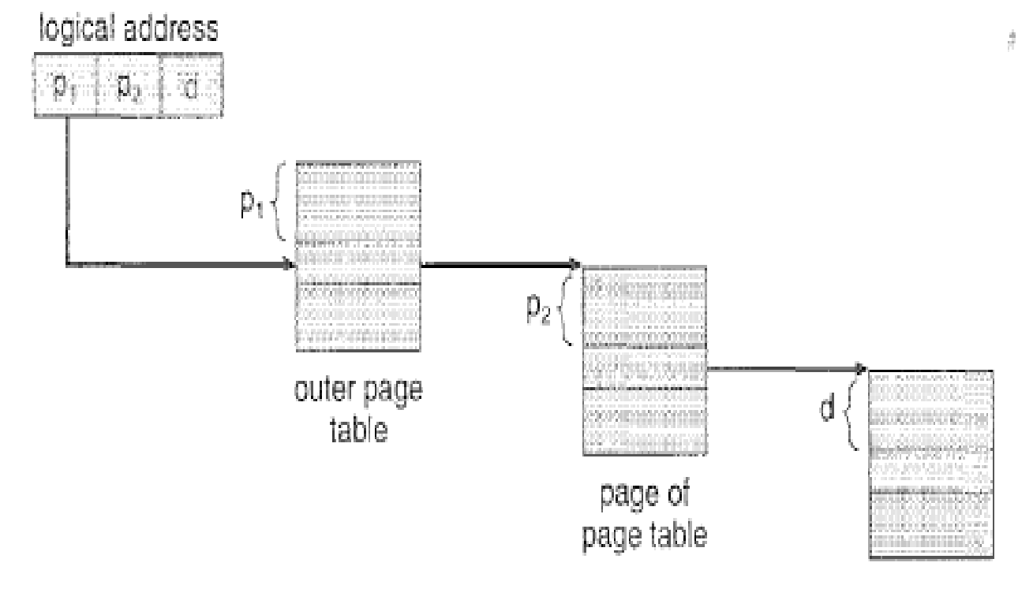
Dept. of AIML
Address translation for a two-level 32-bit paging architecture.

Slide 110
Hashed Page Tables
Used for handling address spaces larger than 32 bits( or large address spaces)
Here,
The hash value is the virtual page number
Each entry in the hash table contains a linked list of elements that hash to the same location.
Each element consists of three fields:
the virtual page number,
(2) the value of the mapped page frame, and
(3) a pointer to the next element in the linked list.
Dept. of AIML

Slide 111
The algorithm works as follows:
The virtual page number in the virtual address is hashed into the hash table.
The virtual page number is compared with field 1 in the first element in the linked list.
If there is a match, the corresponding page frame (field 2) is used to form the desired physical address.
If there is no match, subsequent entries in the linked list are searched for a matching virtual page number.
Dept. of AIML

Slide 112
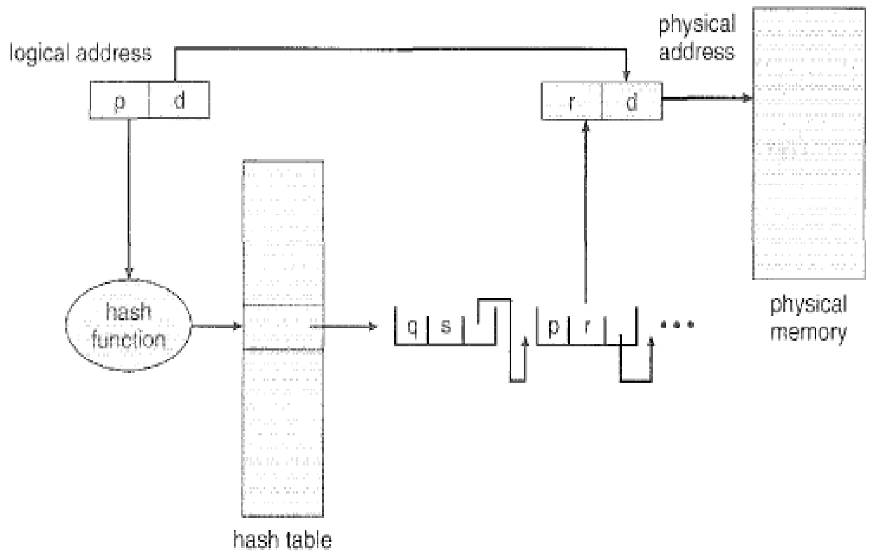
Dept. of AIML
Hashed page Table

Slide 113
Clustered Page Tables
This a variation of the hashed page tables which is favorable for 64- bit address.
It is similar to the hashed page tables except that each entry in the hash table refers to several pages rather than a single page.
Therefore, a single page-table entry can store the mappings for multiple physical-page frames.
Clustered page tables are particularly useful for sparse address spaces, where memory references are noncontiguous and scattered throughout the address space.
Dept. of AIML

Slide 114
Inverted Page Tables
In most Operating systems, a separate page table is maintained for each processes.
So, for ‘n’ number of processes, there will be ‘n’ number of page tables.
For large processes, there would be many pages and for maintaining information about these pages, there would be too many entries in their page tables which itself would occupy a lot of the memory.
Hence memory utilization is not efficient as a lot of memory is wasted in maintaining page tables itself.
Solution to this problem: Use Inverted Page Tables
Dept. of AIML

Slide 115
An inverted page table has one entry for each real page (or frame) of memory.
Each entry consists of the virtual address of the page stored in that real memory location, with information about the process that owns that page.
Thus, only one page table is in the system, and it has only one entry for each page of physical memory.
Each virtual address in the system consists of a triple
<process-id, page-number, offset>.
Each inverted page-table entry is a pair <process-id, page-number>
Dept. of AIML

Slide 116
When a memory reference occurs, part of the virtual address, consisting of <process-id, page number>, is presented to the memory subsystem.
The inverted page table is then searched for a match.
If a match is found-say, at entry i-then the physical address <i, offset> is generated.
If no match is found, then an illegal address access has been attempted.
Dept. of AIML

Slide 117
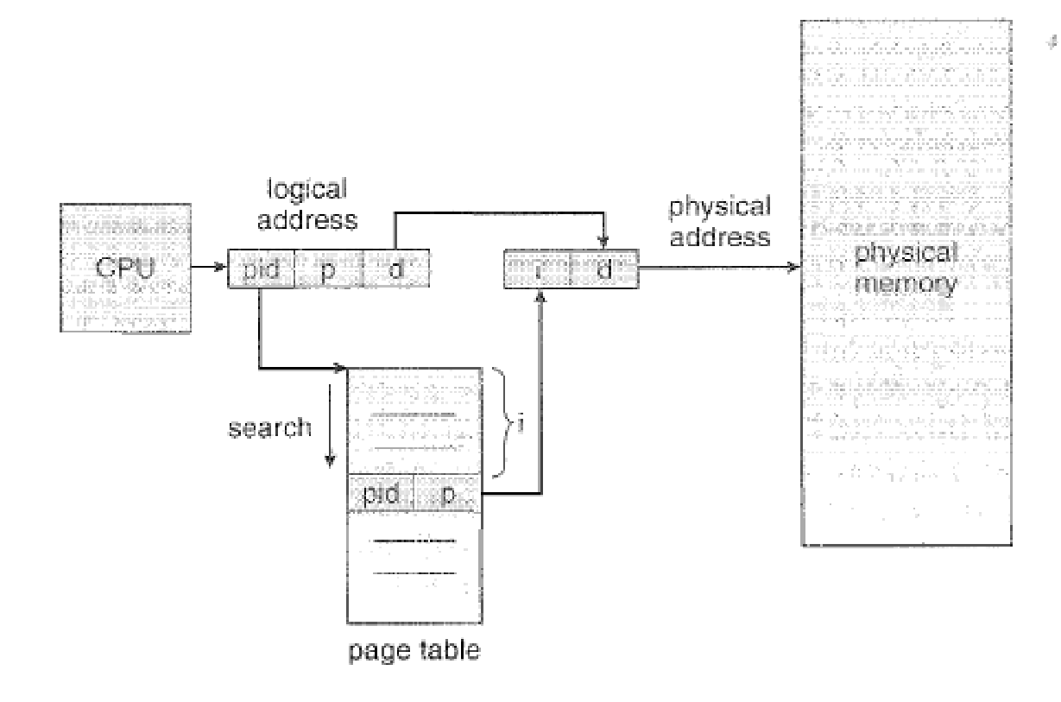
Dept. of AIML
Inverted page table.

Slide 118
Advantages of Inverted Page Tables:
Reduces memory usage.
Disadvantages of Inverted Page Tables:
Increased search time as inverted page table is sorted by physical address, but lookups occur on virtual addresses. The whole table might to be searched for a match.
Difficulty in implementing shared memory.
Dept. of AIML

Slide 119
Segmentation
Segmentation is another non – contiguous memory allocation technique like paging.
Unlike paging, in segmentation, the processes are not divided into fixed size pages.
Instead, the processes are divided into several modules called segments which improves the visualization for the users.
So, here , both secondary memory and main memory are divided into partitions of unequal sizes.
Dept. of AIML

Slide 120
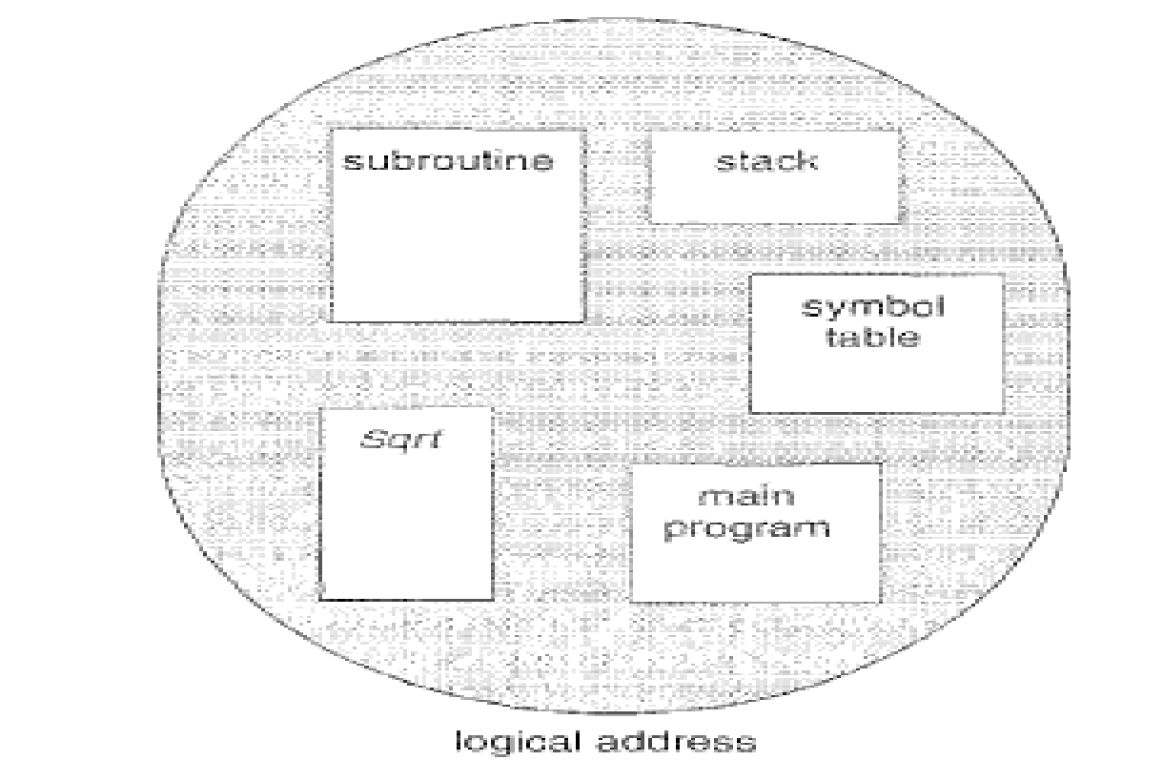
Dept. of AIML
User's view of a program.

Slide 121
A logical address space is a collection of segments.
Each segment has a name and a length.
The addresses specify both the segment name and the offset within the segment.
The user therefore specifies each address by two quantities: A segment name and An offset.
Dept. of AIML

Slide 122
While paging – the user specifies only a single address, which is partitioned by the hardware into a page number and an offset, all invisible to the programmer.
For simplicity of implementation, segments are numbered and are referred to by a segment number, rather than by a segment name.
Thus, a logical address consists of a two tuple:
<segment-number, offset>.
Dept. of AIML

Slide 123
Segment Table
We must define an implementation to map two dimensional user defined addresses into one dimensional physical addresses.
This mapping is done by using a segment table.
Each entry in the segment table has a segment base and a segment limit.
The segment base contains the starting physical address where the segment resides in memory, whereas the segment limit specifies the length of the segment.
Dept. of AIML
 | Limit | Base
Segment 0 | 1000 | 1400
Segment 1 | 400 | 6300
Segment 2 | 400 | 4300
Segment 3 | 1100 | 3200
Segment 4 | 1000 | 4700

Slide 124
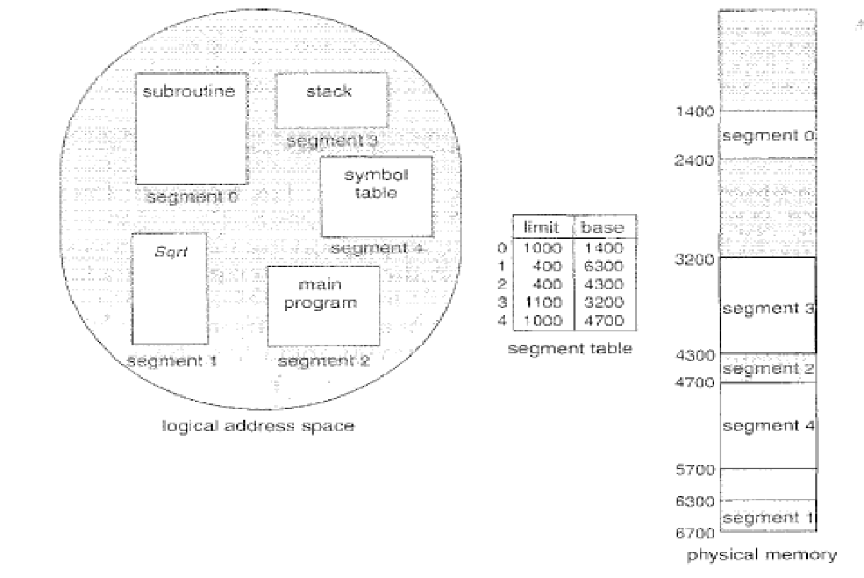
Dept. of AIML
Example of segmentation.

Slide 125
Segmentation Hardware
Although in segmentation the user can now refer to objects in the program by a two dimensional address, the actual physical memory is still, of course, a one dimensional sequence of bytes.
Thus, we must define an implementation to map two dimensional user defined addresses into one dimensional physical addresses.
This is done with the help of a segment table.
Dept. of AIML

Slide 126
A logical address consists of two parts:
A segment number, ‘s’, and an offset into that segment, ‘d’.
The segment number is used as an index to the segment table.
The offset d of the logical address must be between 0 and segment limit.
If it is not, we trap to the OS(logical addressing attempt beyond, end of segment)
When a offset is legal, it is added to the segment base to produce the address in physical memory of the desired byte
Dept. of AIML

Slide 127
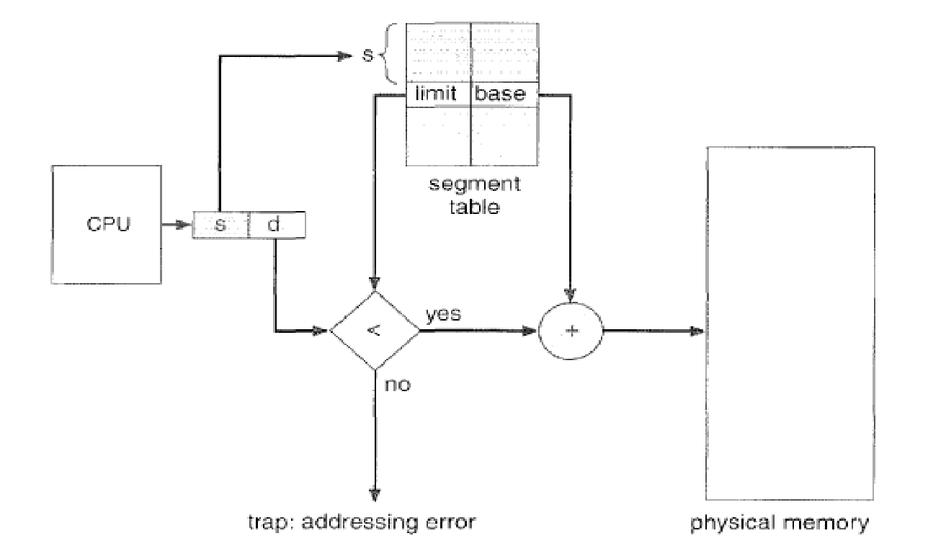
.
Dept. of AIML
Segmentation hardware.

Slide 128
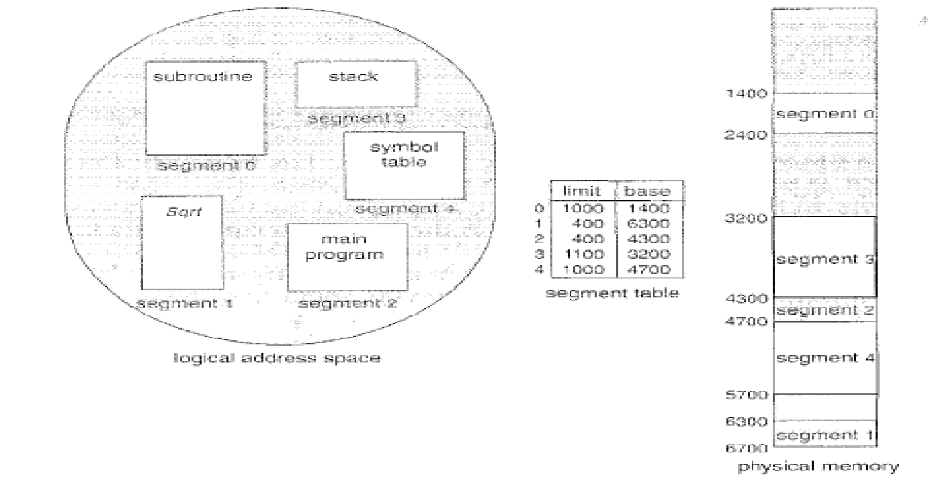
Dept. of AIML
Example: Reference to byte 53 of segment2 mapped to onto location 4300 + 53 = 4353
Reference to byte 852 of segment 3 mapped to onto location 3200 + 852 = 4052
Reference to byte 1222 of segment 0 would result in a trap to the OS, as this segment is only 1000 bytes long.

